Slide 1
SPY Twitter Sentiment
Xiomara Chirinos Juan Zambrano

Slide 2
Agenda
01
Topic Introduction
Brief introduction to financial markets and goals of our project
02
Sentiment Analysis
Using tweets, we analyze regular and financial sentiment
03
Statistical Models
We run classification and forecasting models to predict useful insight in our data
04
Business Applications
We generate a conclusion and indicate a business application to our project

Slide 3
Topic Introduction
$SPY – S & P 500 Index
Evaluating Twitter’s user’s sentiment on the stock market by obtaining tweets about the S & P 500 index and its derivatives.
We will be utilizing financial terms both formal and informal to determine user’s thinking. Bullish or Bearish?
Collect actionable information to be used with a business application.
500
15 Trillion
Bull Market
Biggest Companies in the US
In Market Cap
For the past 12 years in the US
APPLE, AMAZON, MICROSOFT, JPMORGAN, among others
70% to 80% of total US market ca
Long term is upwards in the stock market

Slide 4
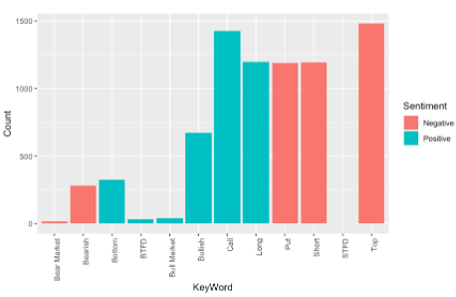
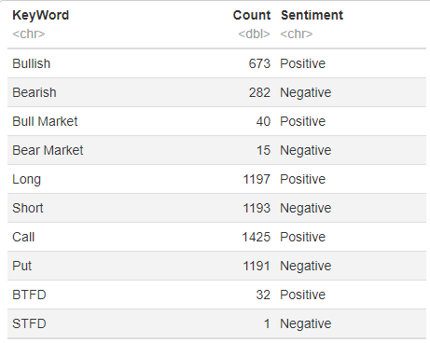
Sentiment Analysis

Slide 5


Sentiment Analysis
Positive
Negative
2000+ mentions
1500 mentions
Calls
Top
Buying calls represents a bullish outlook
Interpreted as a ceiling for stocks
Long
Put
1250 mentions
Less mentioned that calls
Bullish
Mentioned more than bearish
$369.52
BUY
SELL
$369.52

Slide 6

Sentiment Analysis
Trend to remain bullish with caution
SELL
BUY
SELL
Investor to Capitalize current positions and initiate short-term smaller positions to limit downside
BUY

Slide 7
Statistical Models
Results
Results
We can observe a trend in tweets from iPhone users and forecast its direction over 5 days
Results
We are able to classify if our Tweets contain $SPY $SPX in the body of the tweet with an 76% accuracy
Results
Using two models, we can predict if Tweets are Bullish or Bearish with 87% and 88& accuracy
We can predict if a Tweet is Organic or No Organic with a 69% accuracy
Logistic Regression
Decision Trees
Naïve Base Model
Time Series
Clustering

Slide 8
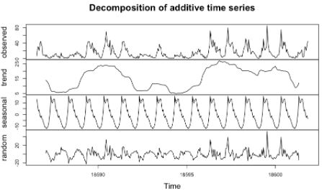
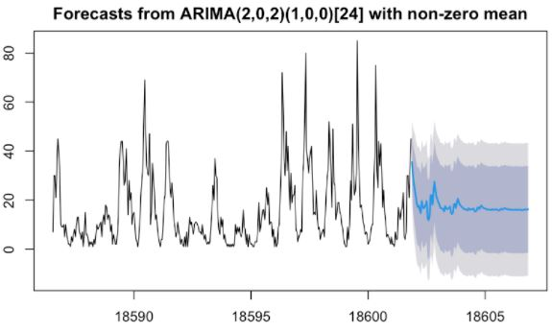
TREND
A TREND IS VISIBLE POTENTIALLY INDICATING AN UPER TREND
A CLEARER SEASONAL TREND IS OBSERVED IN THIS CASE COULD MEAN MORE TWEETS DURING MARKET HOURS
SEASONALITY
OBSERVATION 1
TWEETS CREATED FROM IPHONES WILL INICIATE A SMALL DOWNTRED TO THEN RECOVER AND MANTAIN
OBSERVATION 2
THIS WOULD MEAN A SURGE IN TWEETS FROM DESKTOP AND OTHER MOBILE DIVICES

Slide 9
Business Applications
Capitalize & Reduce
Invest in the now
Protection
Diversify
01
Capitalize and Reduce
03
Protection
Take current profits in the equity markets to reduce exposure to market corrections.
Buy insurance on your current and future assets to prevent sudden devaluation of your equities.
02
Invest in the now
04
Diversify
Initiate short-term investments and capitalize when positive returns.
Create new streams of income other than equity markets. Utilize our statistical models to engage in new ventures. Ex. Invest in iPhone alternatives.

